Slide 1

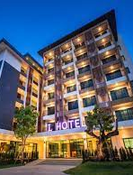
ROOM ON RENT
HOTEL SERVICE SYSTEM

Slide 2
Team Members
VINAY BHARDWAJ
2100290140149
Sec - B
SANYA RASTOGI
2100290140116
Sec – B
DUSHYANT
2100290140063
Sec - b
Supervisor: Mr. Praveen Kumar Gupta
Assistant professor
KIET GROUP OF INSTITUTION

Slide 3
Introduction
Room On Rent Hotel Service System is a website where the management of entire hotel is computerized.
The Room On Rent Hotel Service System is designed using html,css and javascript as the rich GUI for front end and php, MySQL server as the secured backend database.
In this project the following details are maintained like customer details, reservation details, booking details and billing details.
The reservation process of reserving rooms for the customers, cancelling the reserved rooms, booking the rooms, vacating the rooms, the restaurant management, billing process, etc are all computerized, and the management is done without any difficulty.

Slide 4
Objective
In this website, the booking of hotel rooms make this system very flexible and convenient because as we know that the hotel manager is a very busy person and does not have the time to sit and manage the entire activities manually on paper.
This website gives him the power and flexibility to manage the entire system from a single online system.
Customers can view and book room online.
Admin has the power of either approving or disapproving the customer’s booking request.
Hotel services can also be viewed by the customers and can book them too.

Slide 5
Functional requirements
Reservation module: during reservation, the details of the customers, type of room required, and number of room required are fed into the system.
Room booking module: in this module, the admin gives confirmation for the room which is booked by the user.
Room status module: in this module, the admin can see the number of rooms which are reserved, and which are not reserved.
Generate reports: this module deals with the generation of the reports for the various modules. The customer list can be generated. Room status list can be retrieved for reference.

Slide 6
Non-functional requirements
Security: security requirements ensures that the system is protected from unauthorized access to the system and store data.
Reliability: Reliability defines how likely it is for the software work without failure for a given period.
Performance: performance is quality attribute that describes the responsiveness of the system.
Usability: Usability defines how difficult it will be for user to learn and operate the system.

Slide 7
Hardware & Software requirements
Processor : Multi-core – 1.8 GHz processor or better.
RAM : 4GB RAM.
Hard disk : 80GB.
Operating system : Windows 7, 8 and above.
Front End : Html, CSS, JavaScript.
Back End : PHP, MySQL.

Slide 8
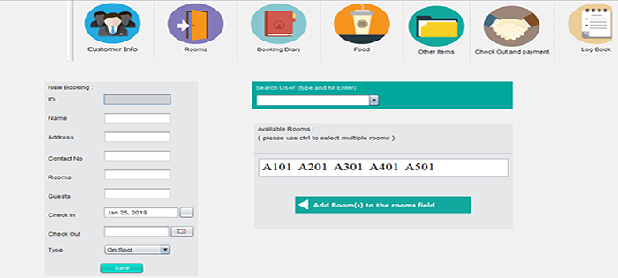

Slide 9
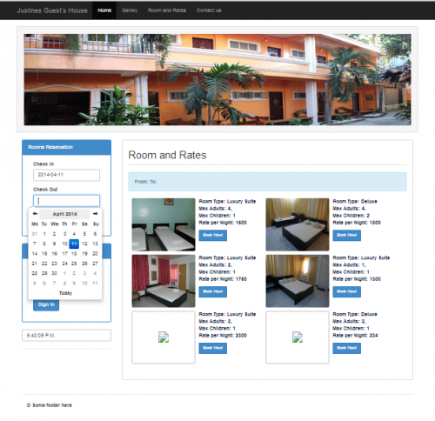

Slide 10
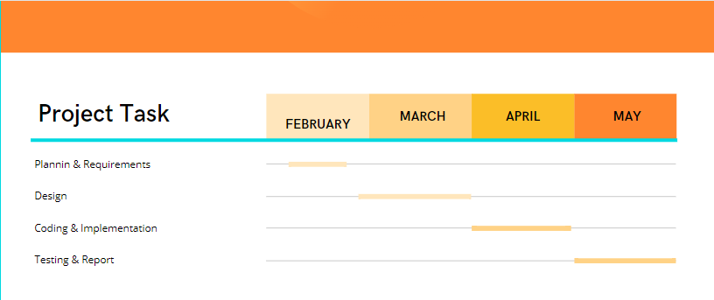

Slide 11
References
https://www.lovelycoding.org/hotel-management-system/
https://www.google.com/url?sa=i&url=https%3A%2F%2Fcode-projects.org%2Fhotel-management-system-in-java-with-source-code%2F&psig=AOvVaw16bFrYzssuCBR0skSZkbUs&ust=1646896629693000&source=images&cd=vfe&ved=0CAsQjRxqFwoTCNCp25q-uPYCFQAAAAAdAAAAABAD
https://www.google.com/url?sa=i&url=https%3A%2F%2Fwww.vetbossel.in%2Fhotel-management-system-php%2F&psig=AOvVaw16bFrYzssuCBR0skSZkbUs&ust=1646896629693000&source=images&cd=vfe&ved=0CAsQjRxqFwoTCNCp25q-uPYCFQAAAAAdAAAAABAY

Slide 12


